Slide 1
DP Path-finding
Jameson Nash
December 14, 2012

Slide 2
Problem Statement
How to use DP to plan optimal path?
Exploration region: Mars
Initial Location: Curiosity Rover

Slide 3
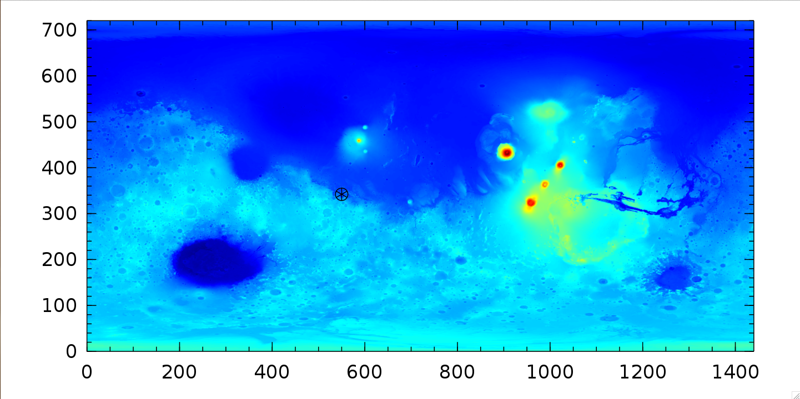
Mars Topo
http://pds-geosciences.wustl.edu/missions/mgs/megdr.html

Slide 4
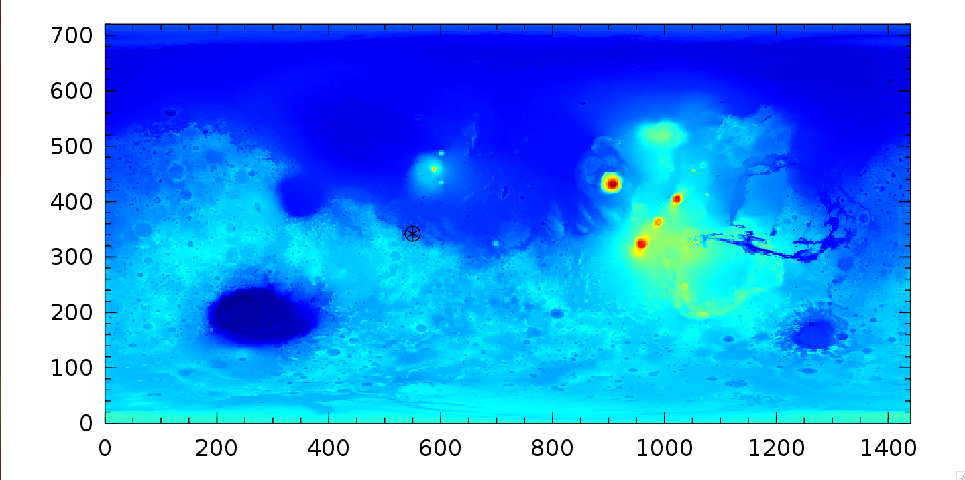

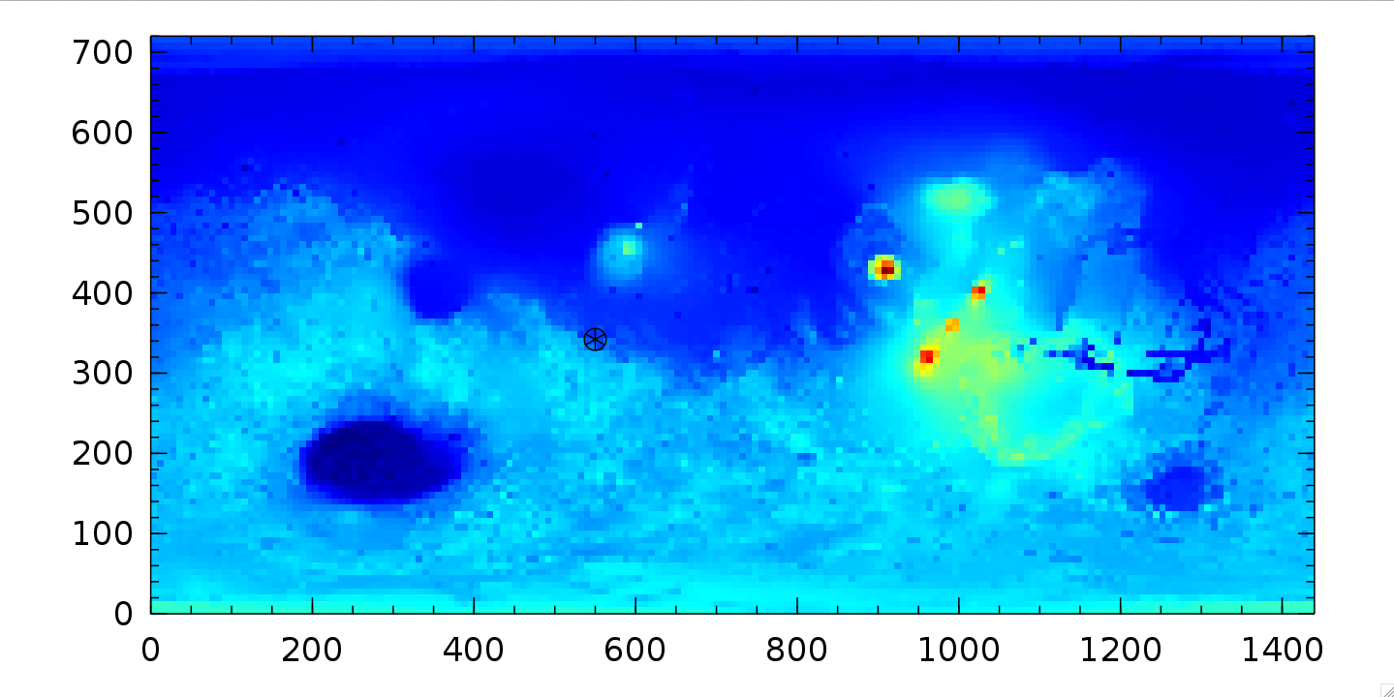
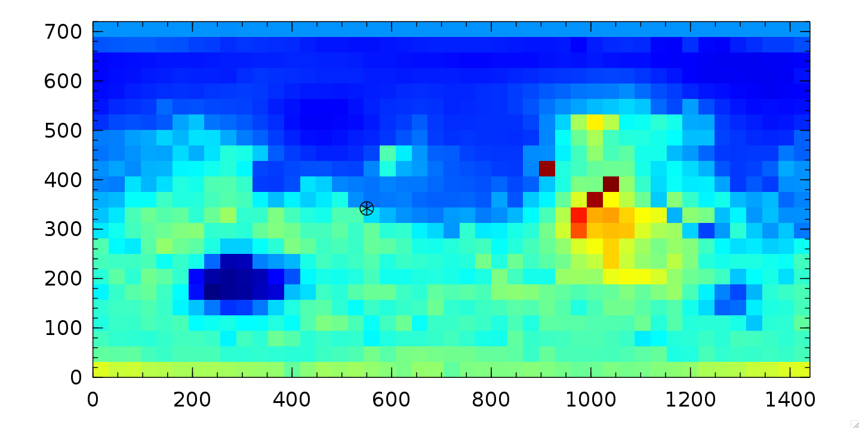
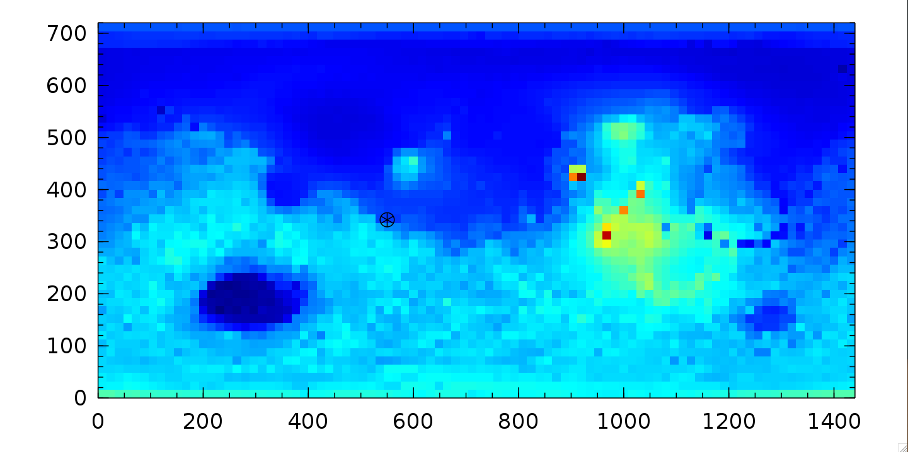
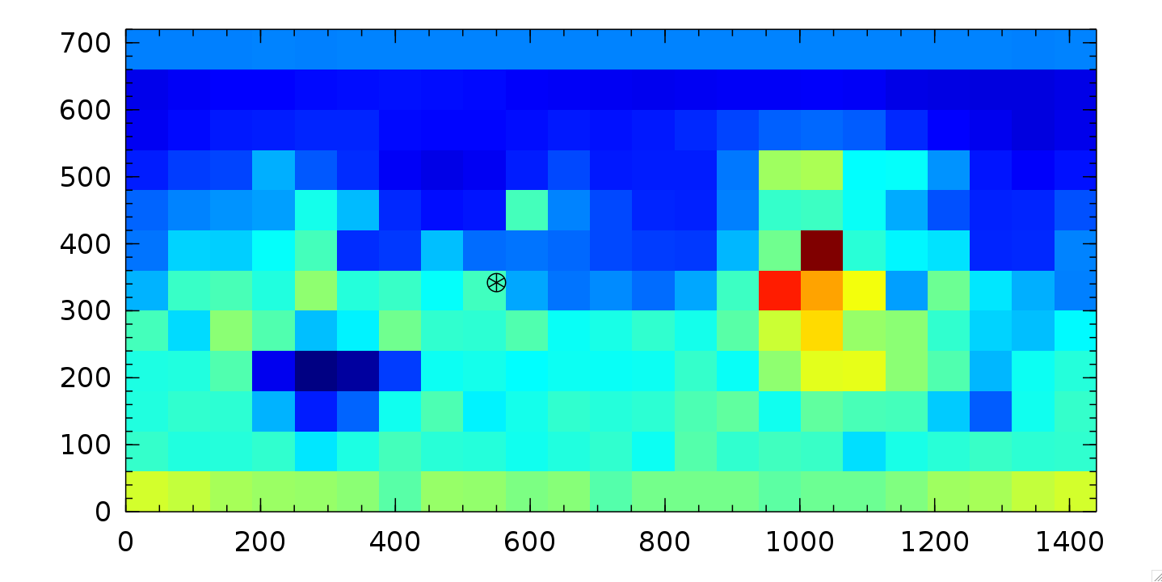
State Approximation
1/2²
1/16²
1/4²
1/32²
1/8²
1/64²

Slide 5
Terrain Travel Costs
# Composed of 2 terms:
(h_{next}– h_{ij}) ## Terrain “roughness”
1 ## Euclidean distance
# shortest path cost
g(i,j,u) = 1 * distance
# small linear cost function
g(i,j,u) = (|h_{next}– h_{ij}|/800 + 1)*distance
# medium squared-cost function
g(i,j,u) = (((h_{next}– h_{ij})/1000)² + 1)*distance

Slide 6
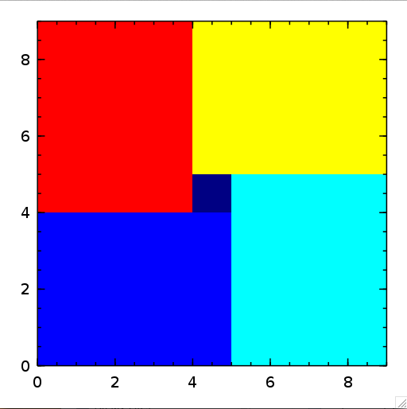
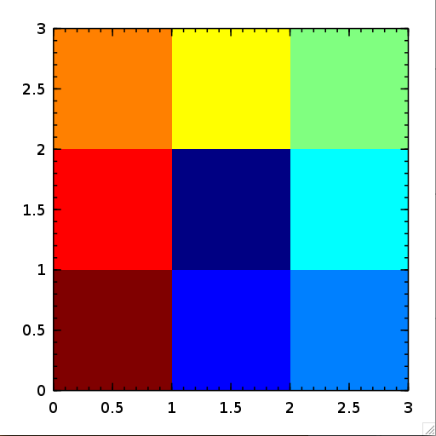
Solution Structure
Initial State
Map Color Key

Slide 7
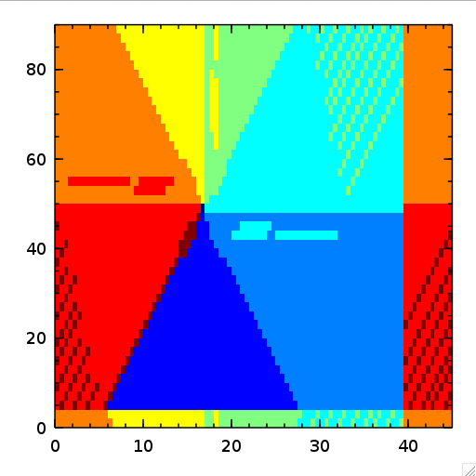
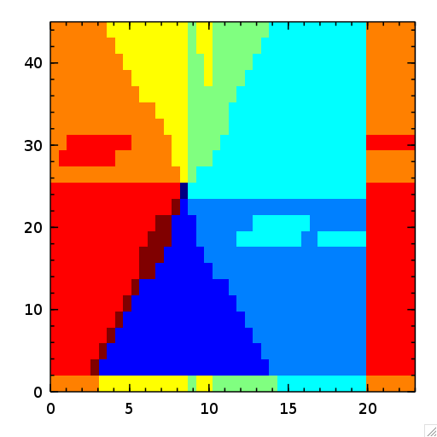
Euclidean distance
1/16²
1/32²

Slide 8
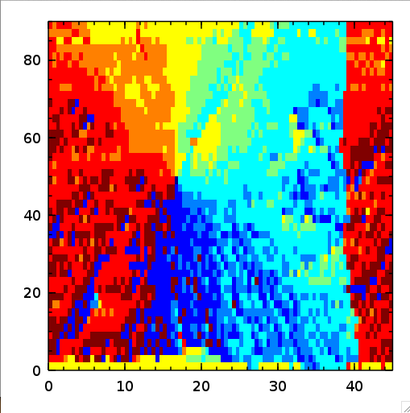
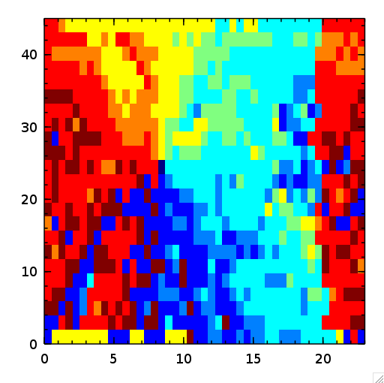
linear cost function, in terrain height difference
1/16²
1/32²

Slide 9
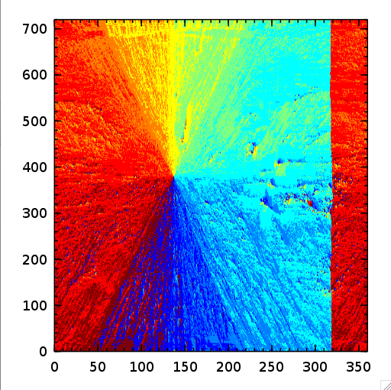
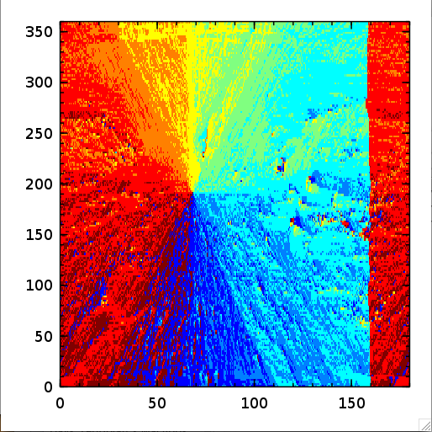
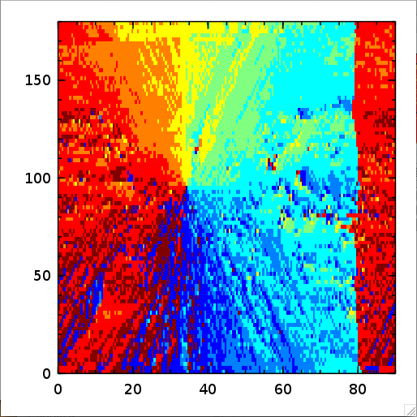
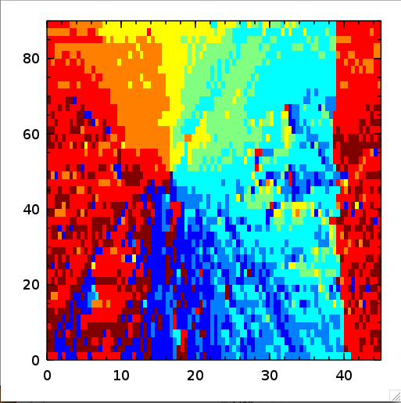
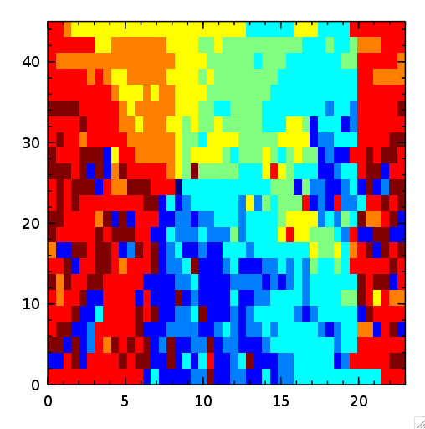
height-difference- squared cost function
reduced by
1/2² to 1/32²

Slide 10
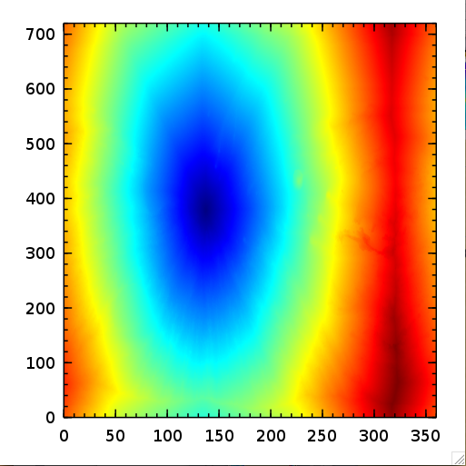
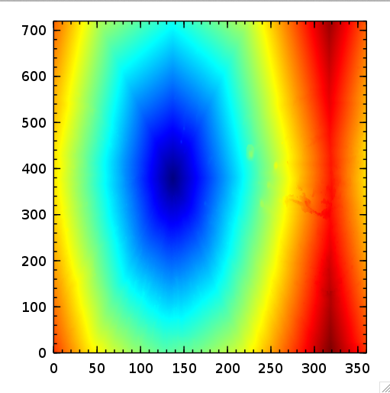
Cost Maps
|terrain| + dist
terrain² + dist

Slide 11
Time cost of DP

Slide 12
Algorithmic cost of DP

Slide 13
Value of Optimistic PI

Slide 14
Questions? and Final Thoughts
Make sure PI starts with a proper policy!
VI most efficient, as problem size grew (in this case)
No obvious algorithmic optimal strategy for Optimistic PI
No obvious translation from macroscopic view (computed directions) to micro (real-time controls)
Can observe N-step rollout from the Nth iteration of PI, in real-time output

